Slide 1
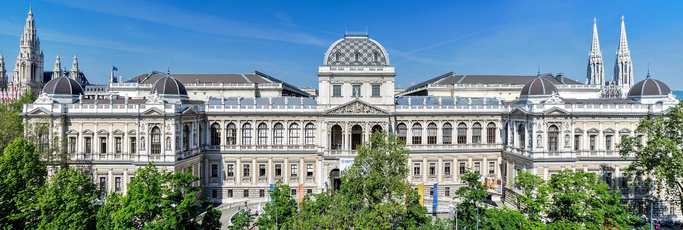
Professionalism and Doctoral Education
4 November 2022 // MARDS Final Conference
Lucas Zinner // University of Vienna

Slide 2
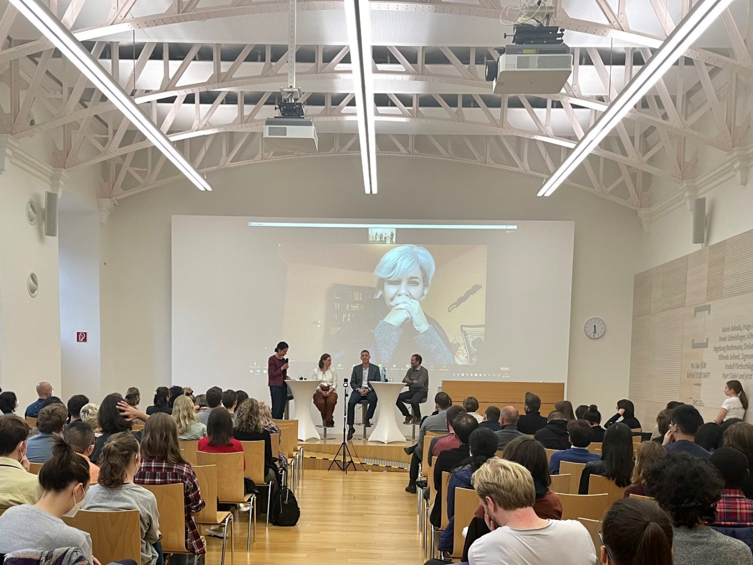
Professionalism
“‘Professionalism’ is commonly understood as an individual’s adherence to a set of standards, code of conduct or collection of qualities that characterize accepted practice within a particular area of activity”
Foto: Welcome days 2022, Panel discussion with VR Baccarini
Notes:
Based on these definitions, what does it look like for a HE manager, a head of a doctoral school, a supervisor… to act with professionalism?
What is the ‘collection of qualities’ that make someone acting with professionalism?

Slide 3
Why professionalism is so important
The highest level of professionalism should always be the benchmark for how we do our work, act in and with our environment and deal with the resources and responsibilities assigned to us.
We have to be reliable and accountable.
Are we trustworthy to work with the most valuable assets within universities?
Skills
Knowledge
Behaviour
Professionalism

Slide 4
Where professionalism is needed
Structure
People
Processes

Slide 5
Structure
Structure
People
Processes
What kind of support structures are in place?
University level
Doctoral school level
Programme level
Department level
Research Group level

Slide 6
Processes
Structure
People
Processes
Are processes transparently described and aligned with the quality requirements in doctoral education?
Recruitment
Onboarding
Public defence
Enrollment
Interim quality reviews
Who is managing the processe?
Who is reviewing the processess?

Slide 7
People
Structure
People
Processes
Professionalism is required and possible at every level.
Academic leadership
Heads of doctoral schools and directors of doctoral programmes
! Familiarity with relevant policy recommendations and good international practice, and their adaptation to local needs and circumstances.

Slide 8
People
Structure
People
Processes
Professionalism is required and possible at every level.
Academic leadership
Heads of doctoral schools and directors of doctoral programmes
Supervisors
! Familiarity with the multiple roles of supervisors, aware of and able to apply different pedagogical approaches appropriate to the PhD candidate and stage of the dissertation process, for a professional working relationship for effective supervision.

Slide 9
People
Structure
People
Processes
Professionalism is required and possible at every level.
Academic leadership
Heads of doctoral schools and directors of doctoral programmes
Supervisors
Professional support staff
! To be a professional it is required to have an holistic understanding of doctoral education and the higher education environment.

Slide 10
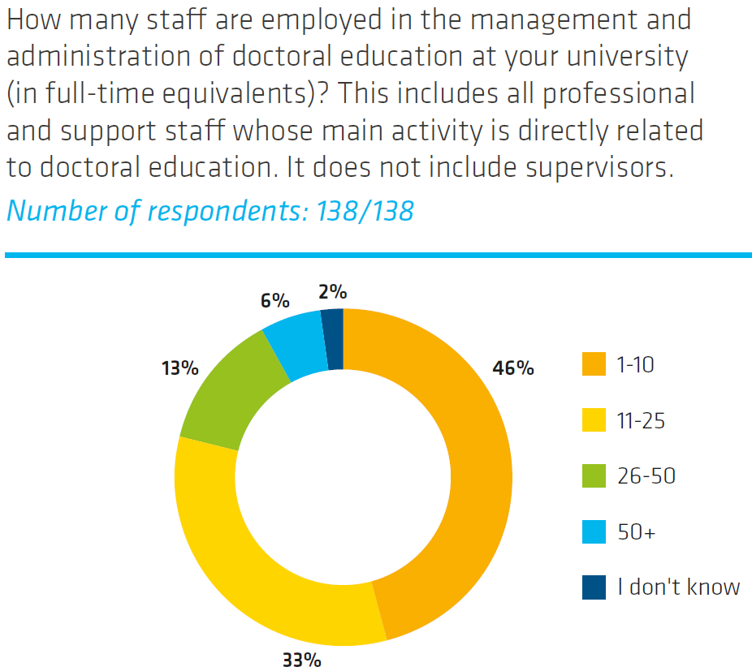
Staff in the management and administration of doctoral education
„In recent years, support structures for doctoral candidates
have increased significantly, and a significant majority of
universities have introduced structural doctoral education
throughout doctoral schools and doctoral programmes.
As a result of this development, universities have had to
equip themselves with adequate specialist staff to respond
to the growing needs of doctoral candidates. “
Source: Doctoral education in Europe: current developments and trends EUA CDE 2022, p. 9

Slide 11
The range of roles and contributions of Professionals in DE
Professionals can play an active part throughout the doctoral journey, e.g.:
Supporting the recruitment and onboarding process
Providing transferable skills trainings
As career advisors for PhD candidates
Supporting the acquisition of funds for doctoral training and doctoral projects
Supporting the internationalization strategy
As advisors to the leadership, e.g. by increasing the organizational knowledge about doctoral education
…

Slide 12
Take home messages
Doctoral Education is the highest form of training and education provided by universities.
It means working with and taking responsibility for the universities' most valuable asset, namely young talent.
Professionalism in doctoral education must be promoted at all levels.
There are sufficient international best practices and examples to learn from.
Use the possibilities that exist to raise doctoral education to an international level.
…and remain patient: Rome was not built in a day.

